Slide 1

An introduction to time series approaches in biosurveillance
Andrew W. Moore
Professor The Auton Lab
School of Computer Science
Carnegie Mellon University http://www.autonlab.org
Associate Member The RODS Lab University of Pittburgh
Carnegie Mellon University http://rods.health.pitt.edu
Note to other teachers and users of these slides. Andrew would be delighted if you found this source material useful in giving your own lectures. Feel free to use these slides verbatim, or to modify them to fit your own needs. PowerPoint originals are available. If you make use of a significant portion of these slides in your own lecture, please include this message, or the following link to the source repository of Andrew’s tutorials: http://www.cs.cmu.edu/~awm/tutorials .
Comments and corrections gratefully received.
awm@cs.cmu.edu 412-268-7599

Slide 2
Univariate Time Series
Signal
Time
Example Signals:
Number of ED visits today
Number of ED visits this hour
Number of Respiratory Cases Today
School absenteeism today
Nyquil Sales today

Slide 3
(When) is there an anomaly?

Slide 4
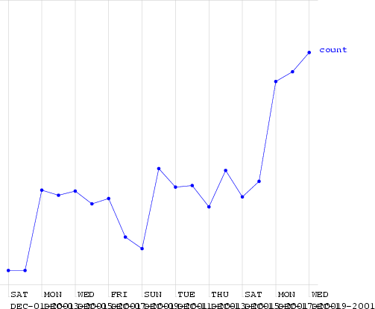
(When) is there an anomaly?
This is a time series of counts of primary-physician visits in data from Norfolk in December 2001. I added a fake outbreak, starting at a certain date. Can you guess when?

Slide 5
(When) is there an anomaly?
Here (much too high for a Friday)
This is a time series of counts of primary-physician visits in data from Norfolk in December 2001. I added a fake outbreak, starting at a certain date. Can you guess when?
(Ramp outbreak)

Slide 6
An easy case
Signal
Time
Dealt with by Statistical Quality Control Record the mean and standard deviation up
the the current time.
Signal an alarm if we go outside 3 sigmas

Slide 7
An easy case: Control Charts
Upper Safe Range
Mean
Signal
Time
Dealt with by Statistical Quality Control Record the mean and standard deviation up
the the current time.
Signal an alarm if we go outside 3 sigmas

Slide 8
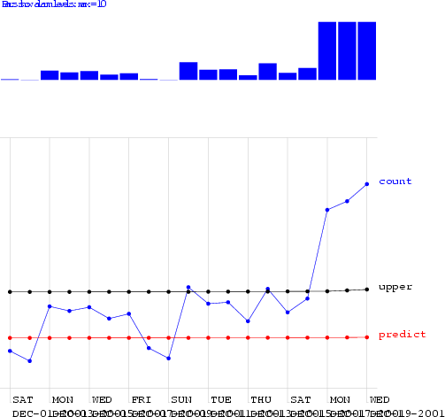
Control Charts on the Norfolk Data
Alarm Level

Slide 9
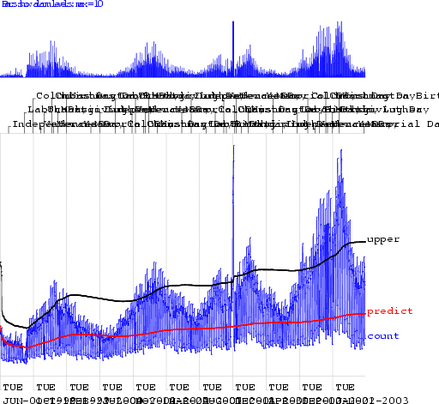
Control Charts on the Norfolk Data
Alarm Level

Slide 10
Looking at changes from yesterday

Slide 11
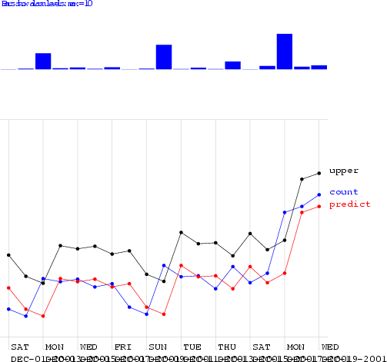
Looking at changes from yesterday
Alarm Level

Slide 12
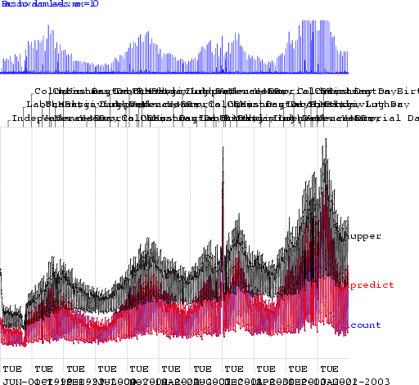
Looking at changes from yesterday
Alarm Level

Slide 13
We need a happy medium:
Control Chart:
Too insensitive to recent changes
Change from yesterday: Too sensitive to recent changes

Slide 14
Moving Average

Slide 15
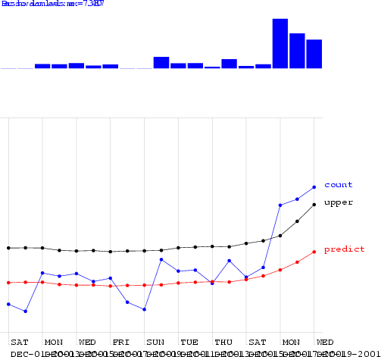
Moving Average

Slide 16
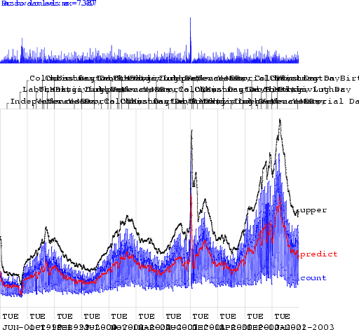
Moving Average

Slide 17
Moving Average
Looks better. But how can we
be quantitative about this?

Slide 18


Algorithm
Allowing one False Alarm per TWO weeks…
Allowing one False Alarm per SIX weeks…
Performance
a ramp
_{Fracti}ou_{n}tb_{o}r_{f}eak
Days to detect
a ramp
_{Fracti}ou_{n}tb_{o}r_{f}eak
Days to detect
spikes detected
spikes detected
standard control chart | 0.39 | 3.47 | 0.22 | 4.13
using yesterday | 0.14 | 3.83 | 0.1 | 4.7
Moving Average 3 0.36 3.45 0.33 3.79
Moving Average 7 0.58 2.79 0.51 3.31
Moving Average 56 0.54 2.72 0.44 3.54
hours_of_daylight 0.58 2.73 0.43 3.9
hours_of_daylight is_mon 0.7 2.25 0.57 3.12
hours_of_daylight is_mon ... is_tue 0.72 1.83 0.57 3.16
hours_of_daylight is_mon ... is_sat 0.77 2.11 0.59 3.26
CUSUM 0.45 2.03 0.15 3.55
sa-mav-1 0.86 1.88 0.74 2.73
sa-mav-7 0.87 1.28 0.83 1.87
sa-mav-14 0.86 1.27 0.82 1.62
sa-regress 0.73 1.76 0.67 2.21
Cough with denominator 0.78 2.15 0.59 2.41
Cough with MA 0.65 2.78 0.57 3.24
18

Slide 19
Semi-synthetic data: spike outbreaks
1. Take a real time series
2. Add a spike of random height on a random date
3. See what alarm levels your algorithm gives on every day of the data
4. On what fraction of non-spike days is there an equal or higher alarm
Only one
5. That’s an example of the false positive rate this algorithm would need if it was going to detect the actual spike.
19

Slide 20
Semi-synthetic data: spike outbreaks
1. Take a real time series
2. Add a spike of random
height on a random date
2. Add a spike of random
height on a random date
2. Add a spike of random
height on a random date
2. Add a spike of random
height on a random date
4
2. Add a spike of random
height on a random date
4
2. Add a spike of random
height on a random date
4
2. Add a spike of random height on a random date
3
3
3
. See what alarm levels your algorithm
gives on every day of the data
. On what fraction of non-spike days is
there an equal or higher alarm
Only one
. See what alarm levels your algorithm
gives on every day of the data
. On what fraction of non-spike days is
there an equal or higher alarm
Only one
. See what alarm levels your algorithm
gives on every day of the data
. On what fraction of non-spike days is
there an equal or higher alarm
Only one
3
. See what alarm levels your algorithm
gives on every day of the data
5
4
. On what fraction of non-spike days i
there an equal or higher alarm
Only one
3
. See what alarm levels your algorithm
gives on every day of the data
5
4
. On what fraction of non-spike day
there an equal or higher alarm
Only o
3
. See what alarm levels your algorithm
gives on every day of the data
r 5
4
. On what fraction of non-spike da
there an equal or higher alarm
Only
3. See what alarm levels your algorithm
4. On what fraction of non-spike
gives on every day of the data
there an equal or higher alarm
Do this 1000 times to
get an average
performance
. That’s an example of the false positive
ate this algorithm would need if it was going o detect the actual spike.
20
. That’s an example of the false positive
ate this algorithm would need if it was going o detect the actual spike.
. That’s an example of the false positive
ate this algorithm would need if it was going o detect the actual spike.
t
r 5
. That’s an example of the false positive
ate this algorithm would need if it was going o detect the actual spike
t
r 5 t
. That’s an example of the false positive
ate this algorithm would need if it was going
r 5
. That’s an example of the false positive
ate this algorithm would need if it was goin
r 5. That’s an example of the false positive
t r

Slide 21
Semi-synthetic data: ramp outbreaks
1. Take a real time series
2. Add a ramp of random height on a random date
3. See what alarm levels your algorithm gives on every day of the data
4. If you allowed a specific false positive rate, how far into the ramp would you be before you signaled an alarm?

Slide 22
Semi-synthetic data: ramp outbreaks
1. Take a real time series
2. Add a ramp of random
height on a random date
2. Add a ramp of random
height on a random date
2. Add a ramp of random
height on a random date
2. Add a ramp of random
height on a random date
4.
2. Add a ramp of random
height on a random date
4.
2. Add a ramp of random
height on a random date
3
3
. See what alarm levels your algorithm
gives on every day of the data
If you allowed a specific false positive
rate, how far into the ramp would you be before you signaled an alarm?
. See what alarm levels your algorithm
gives on every day of the data
If you allowed a specific false positive
rate, how far into the ramp would you be before you signaled an alarm?
3
. See what alarm levels your algorithm
gives on every day of the data
4.
If you allowed a specific false positive
rate, how far into the ramp would you be before you signaled an alarm?
3
. See what alarm levels your algorithm
gives on every day of the data
4.
If you allowed a specific false positive
rate, how far into the ramp would you be before you signaled an alarm?
3
. See what alarm levels your algorithm
gives on every day of the data
4.
If you allowed a specific false positi
rate, how far into the ramp would y be before you signaled an alarm?
3. See what alarm levels your algorithm
4. If you allowed a specific false pos rate, how far into the ramp would
gives on every day of the data
be before you signaled an alarm
Do this 1000 times to
get an average
performance

Slide 23
Evaluation methods
All synthetic

Slide 24
Evaluation methods
All synthetic
You can account for variation in the way the baseline will look.
You can publish evaluation data and share results without data agreement problems
You can easily generate large numbers of tests
You know where the outbreaks are

Slide 25
Evaluation methods
All synthetic
You can account for variation in the way the baseline will look.
You can publish evaluation data and share results without data agreement problems
You can easily generate large numbers of tests
You know where the outbreaks are
Your baseline data might be unrealistic

Slide 26
Evaluation methods
All synthetic
You can account for variation in the way the baseline will look.
You can publish evaluation data and share results without data agreement problems
You can easily generate large numbers of tests
You know where the outbreaks are
Your baseline data might be unrealistic
Semi-Synthetic
Can’t account for variation in the baseline.
You can’t share data
You can easily generate large numbers of tests
You know where the outbreaks are

Slide 27
Evaluation methods
All synthetic
You can account for variation in the way the baseline will look.
You can publish evaluation data and share results without data agreement problems
You can easily generate large numbers of tests
You know where the outbreaks are
Your baseline data might be unrealistic
Semi-Synthetic
Can’t account for variation in the baseline.
You can’t share data
You can easily generate large numbers of tests
You know where the outbreaks are
Don’t know where the outbreaks aren’t

Slide 28
Evaluation methods
All synthetic
You can account for variation in the way the baseline will look.
You can publish evaluation data and share results without data agreement problems
You can easily generate large numbers of tests
You know where the outbreaks are
Your baseline data might be unrealistic
Semi-Synthetic
Can’t account for variation in the baseline.
You can’t share data
You can easily generate large numbers of tests
You know where the outbreaks are
Don’t know where the outbreaks aren’t
Your baseline data is realistic

Slide 29
Evaluation methods
All synthetic
You can account for variation in the way the baseline will look.
You can publish evaluation data and share results without data agreement problems
You can easily generate large numbers of tests
You know where the outbreaks are
Your baseline data might be unrealistic
Semi-Synthetic
Can’t account for variation in the baseline.
You can’t share data
You can easily generate large numbers of tests
You know where the outbreaks are
Don’t know where the outbreaks aren’t
Your baseline data is realistic
Your outbreak data
might be unrealistic

Slide 30
Evaluation methods
All synthetic
You can account for variation in the way the baseline will look.
You can publish evaluation data and share results without data agreement problems
You can easily generate large numbers of tests
You know where the outbreaks are
Your baseline data might be unrealistic
Semi-Synthetic
Can’t account for variation in the baseline.
You can’t share data
You can easily generate large numbers of tests
You know where the outbreaks are
Don’t know where the outbreaks aren’t
Your baseline data is realistic
Your outbreak data
All real
You can’t get many outbreaks to test
You need experts to decide what is an outbreak
Some kinds of outbreak have no available data
You can’t share data
might be unrealistic

Slide 31
Evaluation methods
All synthetic
You can account for variation in the way the baseline will look.
You can publish evaluation data and share results without data agreement problems
You can easily generate large numbers of tests
You know where the outbreaks are
Your baseline data might be unrealistic
Semi-Synthetic
Can’t account for variation in the baseline.
You can’t share data
You can easily generate large numbers of tests
You know where the outbreaks are
Don’t know where the outbreaks aren’t
Your baseline data is realistic
Your outbreak data
All real
You can’t get many outbreaks to test
You need experts to decide what is an outbreak
Some kinds of outbreak have no available data
You can’t share data
Your baseline data is realistic
Your outbreak data is realistic
might be unrealistic
31

Slide 32
Evaluation methods
All synthetic
You can account for variation in the way the baseline will look.
You can publish evaluation data and share results without data agreement problems
You can easily generate large numbers of tests
You know where the outbreaks are
Your baseline data might be unrealistic
Semi-Synthetic
Can’t account for variation in the baseline.
You can’t share data
You can easily generate large numbers of tests
You know where the outbreaks are
Don’t know where the outbreaks aren’t
Your baseline data is realistic
Your outbreak data
All real
You can’t get many outbreaks to test
You need experts to decide what is an outbreak
Some kinds of outbreak have no available data
You can’t share data
Your baseline data is realistic
Your outbreak data is realistic
Is the test typical?
might be unrealistic

Slide 33
Evaluation methods
All synthetic
You can account for variation in the way the baseline will look.
You can publish evaluation data and share results without data agreement problems
You can easily generate large numbers of tests
Semi-Synthetic
Can’t account for variation in the baseline.
You can’t share data
You can easily generate large numbers of tests
You know where the outbreaks are
All real
You can’t get many outbreaks to test
You need experts to decide what is an outbreak
Some kinds of outbreak have no available data
None of these options is satisfactory.
You can’t share data
Don’t know where the outbreaks aren’t
Your baseline data is realistic
Your baseline data is realistic
Your outbreak data is realistic
_{E}valuation of Biosurveillance algorithms is really
You know where the outbreaks are
Your baseline data might be unrealistic
hard. It has got to be. This is ^{a real problem, and}
we must learn to live with it.
Your outbreak data
Is the test typical?
might be unrealistic

Slide 34


Algorithm
Allowing one False Alarm per TWO weeks…
Allowing one False Alarm per SIX weeks…
Performance
a ramp
_{Fracti}ou_{n}tb_{o}r_{f}eak
Days to detect
a ramp
_{Fracti}ou_{n}tb_{o}r_{f}eak
Days to detect
spikes detected
spikes detected
standard control chart | 0.39 | 3.47 | 0.22 | 4.13
using yesterday | 0.14 | 3.83 | 0.1 | 4.7
Moving Average 3 0.36 3.45 0.33 3.79
Moving Average 7 | 0.58 | 2.79 | 0.51 | 3.31
Moving Average 56 0.54 2.72 0.44 3.54
hours_of_daylight 0.58 2.73 0.43 3.9
hours_of_daylight is_mon 0.7 2.25 0.57 3.12
hours_of_daylight is_mon ... is_tue 0.72 1.83 0.57 3.16
hours_of_daylight is_mon ... is_sat 0.77 2.11 0.59 3.26
CUSUM 0.45 2.03 0.15 3.55
sa-mav-1 0.86 1.88 0.74 2.73
sa-mav-7 0.87 1.28 0.83 1.87
sa-mav-14 0.86 1.27 0.82 1.62
sa-regress 0.73 1.76 0.67 2.21
Cough with denominator 0.78 2.15 0.59 2.41
Cough with MA 0.65 2.78 0.57 3.24
34

Slide 35


Algorithm
Allowing one False Alarm per TWO weeks…
Allowing one False Alarm per SIX weeks…
Performance
a ramp
_{Fracti}ou_{n}tb_{o}r_{f}eak
Days to detect
a ramp
_{Fracti}ou_{n}tb_{o}r_{f}eak
Days to detect
spikes detected
spikes detected
standard control chart | 0.39 | 3.47 | 0.22 | 4.13
using yesterday | 0.14 | 3.83 | 0.1 | 4.7
Moving Average 3 | 0.36 | 3.45 | 0.33 | 3.79
Moving Average 7 | 0.58 | 2.79 | 0.51 | 3.31
Moving Average 56 | 0.54 | 2.72 | 0.44 | 3.54
hours_of_daylight 0.58 2.73 0.43 3.9
hours_of_daylight is_mon 0.7 2.25 0.57 3.12
hours_of_daylight is_mon ... is_tue 0.72 1.83 0.57 3.16
hours_of_daylight is_mon ... is_sat 0.77 2.11 0.59 3.26
CUSUM 0.45 2.03 0.15 3.55
sa-mav-1 0.86 1.88 0.74 2.73
sa-mav-7 0.87 1.28 0.83 1.87
sa-mav-14 0.86 1.27 0.82 1.62
sa-regress 0.73 1.76 0.67 2.21
Cough with denominator 0.78 2.15 0.59 2.41
Cough with MA 0.65 2.78 0.57 3.24
35

Slide 36
Seasonal Effects
Signal
Time
Fit a periodic function (e.g. sine wave) to previous data. Predict today’s signal and 3-sigma confidence intervals. Signal an alarm if we’re off.
Reduces False alarms from Natural outbreaks. Different times of year deserve different thresholds.
36

Slide 37


Algorithm
Allowing one False Alarm per TWO weeks…
Allowing one False Alarm per SIX weeks…
Performance
a ramp
_{Fracti}ou_{n}tb_{o}r_{f}eak
Days to detect
a ramp
_{Fracti}ou_{n}tb_{o}r_{f}eak
Days to detect
spikes detected
spikes detected
standard control chart | 0.39 | 3.47 | 0.22 | 4.13
using yesterday | 0.14 | 3.83 | 0.1 | 4.7
Moving Average 3 | 0.36 | 3.45 | 0.33 | 3.79
Moving Average 7 | 0.58 | 2.79 | 0.51 | 3.31
Moving Average 56 | 0.54 | 2.72 | 0.44 | 3.54
hours_of_daylight | 0.58 | 2.73 | 0.43 | 3.9
hours_of_daylight is_mon 0.7 2.25 0.57 3.12
hours_of_daylight is_mon ... is_tue 0.72 1.83 0.57 3.16
hours_of_daylight is_mon ... is_sat 0.77 2.11 0.59 3.26
CUSUM 0.45 2.03 0.15 3.55
sa-mav-1 0.86 1.88 0.74 2.73
sa-mav-7 0.87 1.28 0.83 1.87
sa-mav-14 0.86 1.27 0.82 1.62
sa-regress 0.73 1.76 0.67 2.21
Cough with denominator 0.78 2.15 0.59 2.41
Cough with MA 0.65 2.78 0.57 3.24
37

Slide 38
Day-of-week effects
Fit a day-of-week component E[Signal] = a + delta_{day}
E.G: delta_{mon}= +5.42, delta_{tue}= +2.20, delta_{wed}=
+3.33, delta_{thu}= +3.10, delta_{fri}= +4.02,
delta_{sat}= -12.2, delta_{sun}= -23.42
A simple form of ANOVA

Slide 39
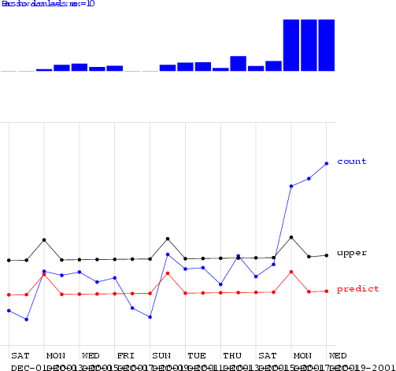
Regression using Hours-in-day & IsMonday

Slide 40
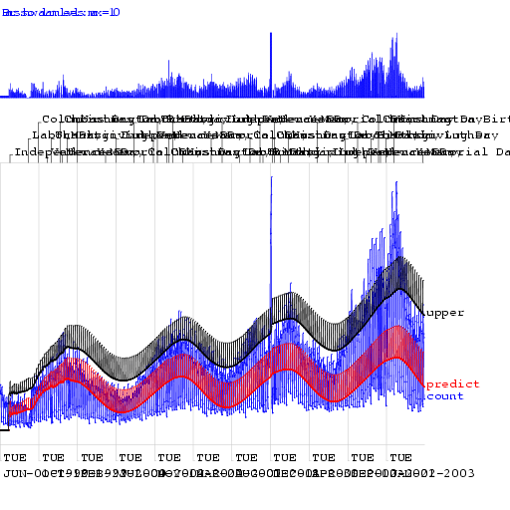
Regression using Hours-in-day & IsMonday

Slide 41


Algorithm
Allowing one False Alarm per TWO weeks…
Allowing one False Alarm per SIX weeks…
Performance
a ramp
_{Fracti}ou_{n}tb_{o}r_{f}eak
Days to detect
a ramp
_{Fracti}ou_{n}tb_{o}r_{f}eak
Days to detect
spikes detected
spikes detected
standard control chart | 0.39 | 3.47 | 0.22 | 4.13
using yesterday | 0.14 | 3.83 | 0.1 | 4.7
Moving Average 3 | 0.36 | 3.45 | 0.33 | 3.79
Moving Average 7 | 0.58 | 2.79 | 0.51 | 3.31
Moving Average 56 | 0.54 | 2.72 | 0.44 | 3.54
hours_of_daylight | 0.58 | 2.73 | 0.43 | 3.9
hours_of_daylight is_mon | 0.7 | 2.25 | 0.57 | 3.12
hours_of_daylight is_mon ... is_tue 0.72 1.83 0.57 3.16
hours_of_daylight is_mon ... is_sat 0.77 2.11 0.59 3.26
CUSUM 0.45 2.03 0.15 3.55
sa-mav-1 0.86 1.88 0.74 2.73
sa-mav-7 0.87 1.28 0.83 1.87
sa-mav-14 0.86 1.27 0.82 1.62
sa-regress 0.73 1.76 0.67 2.21
Cough with denominator 0.78 2.15 0.59 2.41
Cough with MA 0.65 2.78 0.57 3.24
41

Slide 42
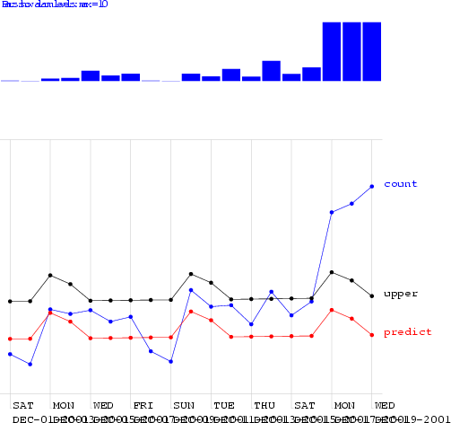
Regression using Mon-Tue
42

Slide 43


Algorithm
Allowing one False Alarm per TWO weeks…
Allowing one False Alarm per SIX weeks…
Performance
a ramp
_{Fracti}ou_{n}tb_{o}r_{f}eak
Days to detect
a ramp
_{Fracti}ou_{n}tb_{o}r_{f}eak
Days to detect
spikes detected
spikes detected
standard control chart | 0.39 | 3.47 | 0.22 | 4.13
using yesterday | 0.14 | 3.83 | 0.1 | 4.7
Moving Average 3 | 0.36 | 3.45 | 0.33 | 3.79
Moving Average 7 | 0.58 | 2.79 | 0.51 | 3.31
Moving Average 56 | 0.54 | 2.72 | 0.44 | 3.54
hours_of_daylight | 0.58 | 2.73 | 0.43 | 3.9
hours_of_daylight is_mon | 0.7 | 2.25 | 0.57 | 3.12
hours_of_daylight is_mon ... is_tue | 0.72 | 1.83 | 0.57 | 3.16
hours_of_daylight is_mon ... is_sat | 0.77 | 2.11 | 0.59 | 3.26
CUSUM 0.45 2.03 0.15 3.55
sa-mav-1 0.86 1.88 0.74 2.73
sa-mav-7 0.87 1.28 0.83 1.87
sa-mav-14 0.86 1.27 0.82 1.62
sa-regress 0.73 1.76 0.67 2.21
Cough with denominator 0.78 2.15 0.59 2.41
Cough with MA 0.65 2.78 0.57 3.24
43

Slide 44
CUSUM
CUmulative SUM Statistics
Keep a running sum of “surprises”: a sum of excesses each day over the prediction
When this sum exceeds threshold, signal alarm and reset sum

Slide 45
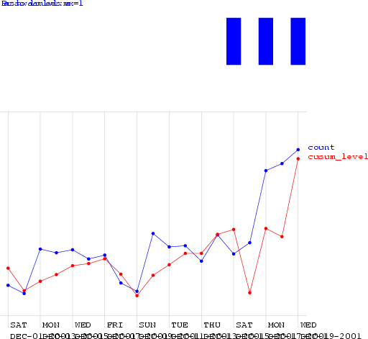
CUSUM

Slide 46
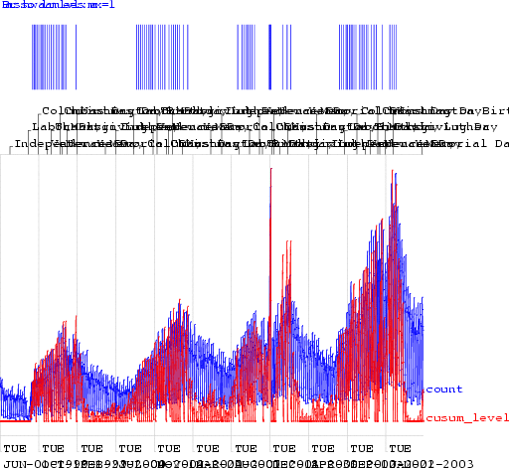
CUSUM

Slide 47


Algorithm
Allowing one False Alarm per TWO weeks…
Allowing one False Alarm per SIX weeks…
Performance
a ramp
_{Fracti}ou_{n}tb_{o}r_{f}eak
Days to detect
a ramp
_{Fracti}ou_{n}tb_{o}r_{f}eak
Days to detect
spikes detected
spikes detected
standard control chart | 0.39 | 3.47 | 0.22 | 4.13
using yesterday | 0.14 | 3.83 | 0.1 | 4.7
Moving Average 3 | 0.36 | 3.45 | 0.33 | 3.79
Moving Average 7 | 0.58 | 2.79 | 0.51 | 3.31
Moving Average 56 | 0.54 | 2.72 | 0.44 | 3.54
hours_of_daylight | 0.58 | 2.73 | 0.43 | 3.9
hours_of_daylight is_mon | 0.7 | 2.25 | 0.57 | 3.12
hours_of_daylight is_mon ... is_tue | 0.72 | 1.83 | 0.57 | 3.16
hours_of_daylight is_mon ... is_sat | 0.77 | 2.11 | 0.59 | 3.26
CUSUM | 0.45 | 2.03 | 0.15 | 3.55
sa-mav-1 0.86 1.88 0.74 2.73
sa-mav-7 0.87 1.28 0.83 1.87
sa-mav-14 0.86 1.27 0.82 1.62
sa-regress 0.73 1.76 0.67 2.21
Cough with denominator 0.78 2.15 0.59 2.41
Cough with MA 0.65 2.78 0.57 3.24
47

Slide 48
The Sickness/Availability Model

Slide 49
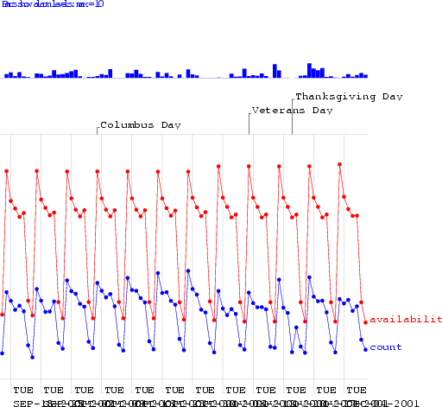
The Sickness/Availability Model

Slide 50
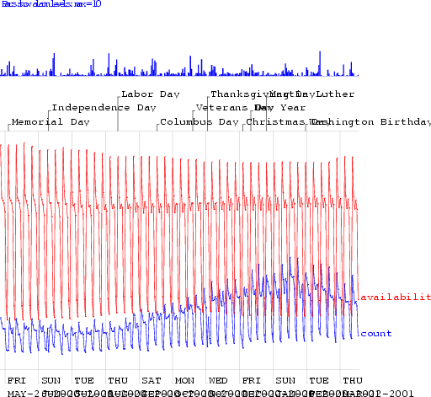
The Sickness/Availability Model

Slide 51
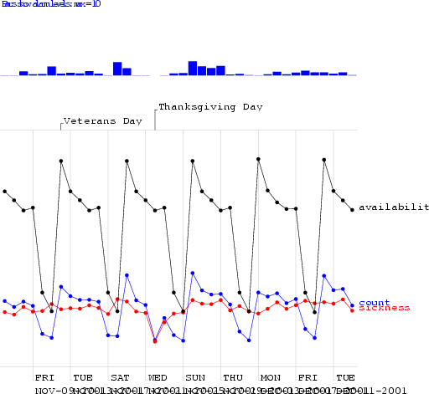
The Sickness/Availability Model

Slide 52
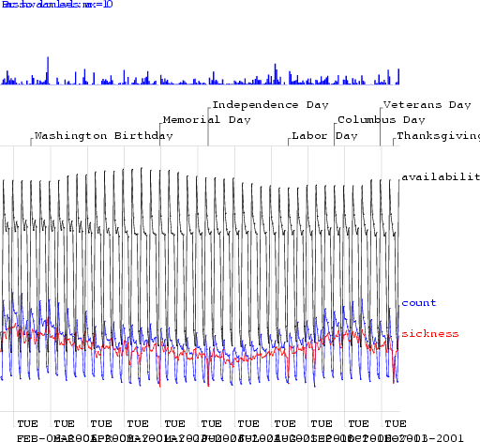
The Sickness/Availability Model

Slide 53
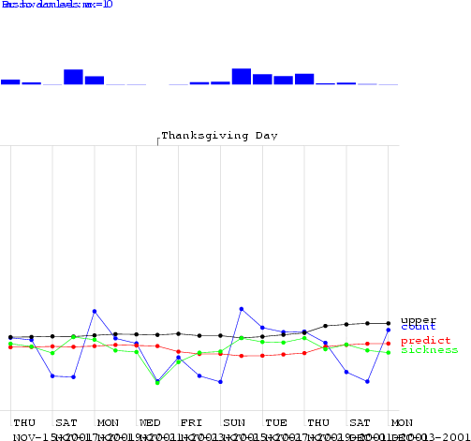
The Sickness/Availability Model

Slide 54
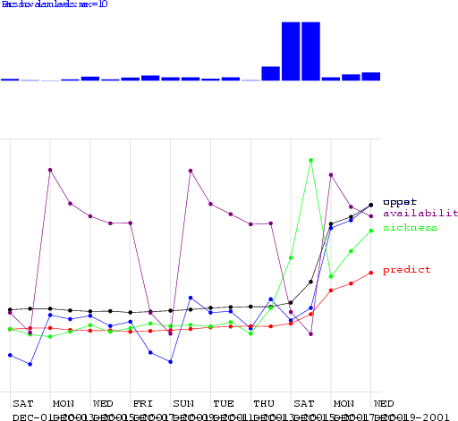
The Sickness/Availability Model

Slide 55
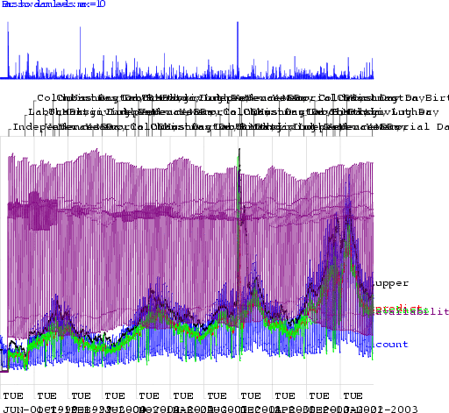
The Sickness/Availability Model

Slide 56


Algorithm
Allowing one False Alarm per TWO weeks…
Allowing one False Alarm per SIX weeks…
Performance
a ramp
_{Fracti}ou_{n}tb_{o}r_{f}eak
Days to detect
a ramp
_{Fracti}ou_{n}tb_{o}r_{f}eak
Days to detect
spikes detected
spikes detected
standard control chart | 0.39 | 3.47 | 0.22 | 4.13
using yesterday | 0.14 | 3.83 | 0.1 | 4.7
Moving Average 3 | 0.36 | 3.45 | 0.33 | 3.79
Moving Average 7 | 0.58 | 2.79 | 0.51 | 3.31
Moving Average 56 | 0.54 | 2.72 | 0.44 | 3.54
hours_of_daylight | 0.58 | 2.73 | 0.43 | 3.9
hours_of_daylight is_mon | 0.7 | 2.25 | 0.57 | 3.12
hours_of_daylight is_mon ... is_tue | 0.72 | 1.83 | 0.57 | 3.16
hours_of_daylight is_mon ... is_sat | 0.77 | 2.11 | 0.59 | 3.26
CUSUM | 0.45 | 2.03 | 0.15 | 3.55
sa-mav-1 | 0.86 | 1.88 | 0.74 | 2.73
sa-mav-7 | 0.87 | 1.28 | 0.83 | 1.87
sa-mav-14 | 0.86 | 1.27 | 0.82 | 1.62
sa-regress 0.73 1.76 0.67 2.21
Cough with denominator 0.78 2.15 0.59 2.41
Cough with MA 0.65 2.78 0.57 3.24
56

Slide 57


Algorithm
Allowing one False Alarm per TWO weeks…
Allowing one False Alarm per SIX weeks…
Performance
a ramp
_{Fracti}ou_{n}tb_{o}r_{f}eak
Days to detect
a ramp
_{Fracti}ou_{n}tb_{o}r_{f}eak
Days to detect
spikes detected
spikes detected
standard control chart | 0.39 | 3.47 | 0.22 | 4.13
using yesterday | 0.14 | 3.83 | 0.1 | 4.7
Moving Average 3 | 0.36 | 3.45 | 0.33 | 3.79
Moving Average 7 | 0.58 | 2.79 | 0.51 | 3.31
Moving Average 56 | 0.54 | 2.72 | 0.44 | 3.54
hours_of_daylight | 0.58 | 2.73 | 0.43 | 3.9
hours_of_daylight is_mon | 0.7 | 2.25 | 0.57 | 3.12
hours_of_daylight is_mon ... is_tue | 0.72 | 1.83 | 0.57 | 3.16
hours_of_daylight is_mon ... is_sat | 0.77 | 2.11 | 0.59 | 3.26
CUSUM | 0.45 | 2.03 | 0.15 | 3.55
sa-mav-1 | 0.86 | 1.88 | 0.74 | 2.73
sa-mav-7 | 0.87 | 1.28 | 0.83 | 1.87
sa-mav-14 | 0.86 | 1.27 | 0.82 | 1.62
sa-regress | 0.73 | 1.76 | 0.67 | 2.21
Cough with denominator 0.78 2.15 0.59 2.41
Cough with MA 0.65 2.78 0.57 3.24
57

Slide 58
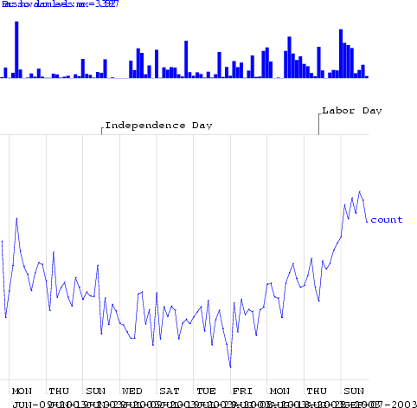
Exploiting Denominator Data

Slide 59
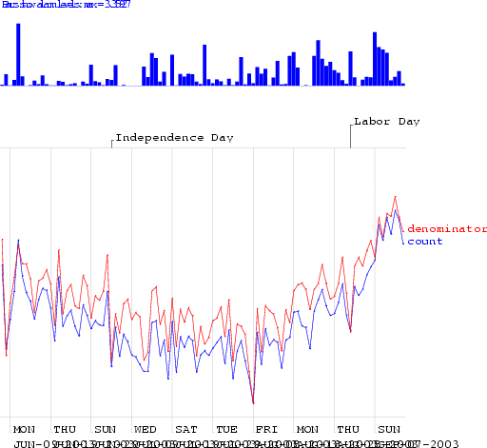
Exploiting Denominator Data

Slide 60
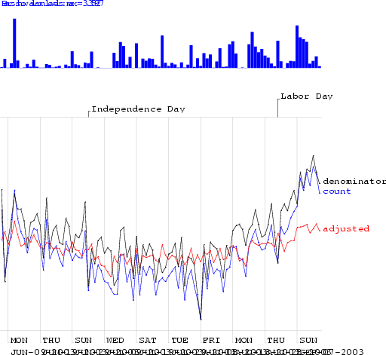
Exploiting Denominator Data

Slide 61
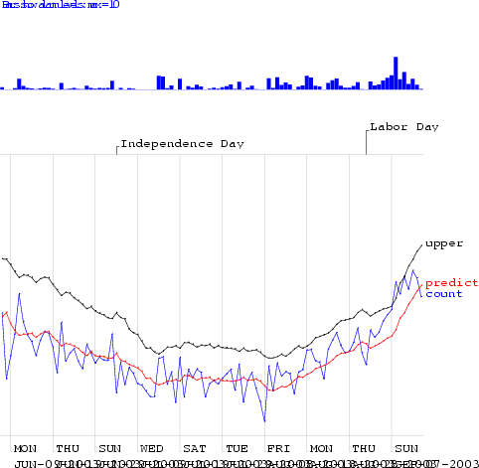
Exploiting Denominator Data

Slide 62


Algorithm
Allowing one False Alarm per TWO weeks…
Allowing one False Alarm per SIX weeks…
Performance
a ramp
_{Fracti}ou_{n}tb_{o}r_{f}eak
Days to detect
a ramp
_{Fracti}ou_{n}tb_{o}r_{f}eak
Days to detect
spikes detected
spikes detected
standard control chart | 0.39 | 3.47 | 0.22 | 4.13
using yesterday | 0.14 | 3.83 | 0.1 | 4.7
Moving Average 3 | 0.36 | 3.45 | 0.33 | 3.79
Moving Average 7 | 0.58 | 2.79 | 0.51 | 3.31
Moving Average 56 | 0.54 | 2.72 | 0.44 | 3.54
hours_of_daylight | 0.58 | 2.73 | 0.43 | 3.9
hours_of_daylight is_mon | 0.7 | 2.25 | 0.57 | 3.12
hours_of_daylight is_mon ... is_tue | 0.72 | 1.83 | 0.57 | 3.16
hours_of_daylight is_mon ... is_sat | 0.77 | 2.11 | 0.59 | 3.26
CUSUM | 0.45 | 2.03 | 0.15 | 3.55
sa-mav-1 | 0.86 | 1.88 | 0.74 | 2.73
sa-mav-7 | 0.87 | 1.28 | 0.83 | 1.87
sa-mav-14 | 0.86 | 1.27 | 0.82 | 1.62
sa-regress | 0.73 | 1.76 | 0.67 | 2.21
Cough with denominator | 0.78 | 2.15 | 0.59 | 2.41
Cough with MA | 0.65 | 2.78 | 0.57 | 3.24

Slide 63
Show Walkerton Results

Slide 64
Other state-of-the-art methods
Wavelets
Change-point detection
Kalman filters
Hidden Markov Models

